Slide 1
Interactive Notebooks
Mrs. Hunt

Slide 2
Your First and Last Name
A day class period/B Day class Period

Slide 3
Instructions
Cut out all handouts around the text on the page.
Select your color tape and leave it on the table beside you.

Slide 4
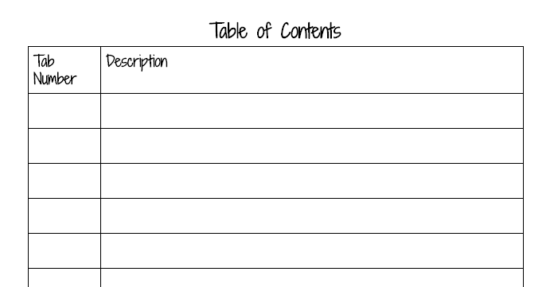
Instructions
Flip to the first page in your notebook and attach the Table of Contents sheet with one piece of tape at the top and one piece of tape at the bottom.

Slide 5
Tab
Fold a piece of tape about an inch long over the end of this single piece of paper so that there is a tab hanging off the edge.
Make sure the tab is not too long or too short.
Add pic of tab.

Slide 6
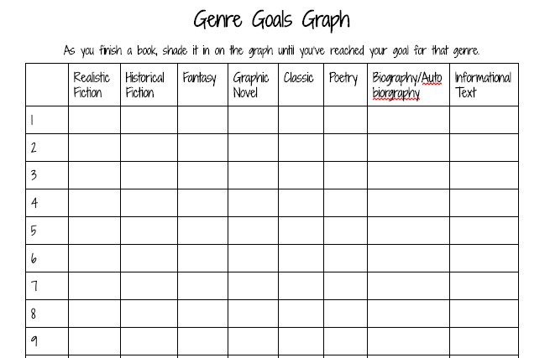
Instructions
Flip to the next page (not the back of that page) and tape in the Genre Goals Graph.
Make a tab on this page that is a little below the first tab when you shut your notebook.

Slide 7
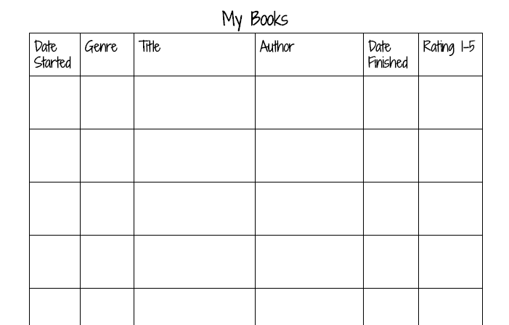
Instructions
Flip to the next page (not the back of this page) and tape on the My Books sheet.
Make your third tab below the second tab when you shut your notebook.

Slide 8
Instructions
Flip to THE BACK of that page and tape in the other My Books sheet.

Slide 9
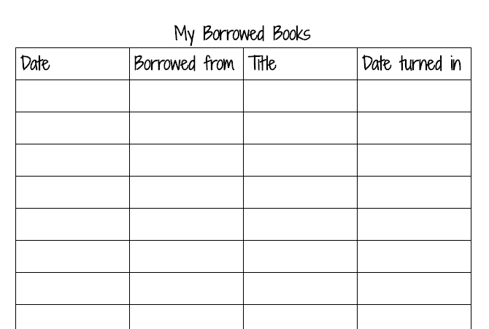
Instructions
Flip 4 pages. Tape in the My Borrowed Books sheet.
You know what to do with the tabs now.

Slide 10
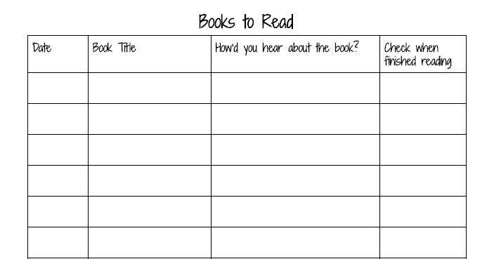
Instructions
Flip to the next page and tape in Books to Read.
Tab it.

Slide 11
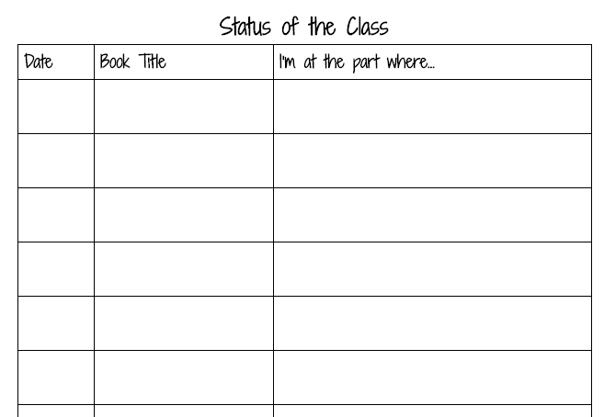
Instructions
Flip to the next page and tape in Status of the Class

Slide 12
Instructions
Flip to the next page. At the top, write “Journal”
Don’t tape anything down.
Put tab number 7.

Slide 13
Instructions
Skip about 30 pages.
At the top of the page write “Bellringer Notes”
Don’t tape anything down.
Tab it.

Slide 14
Instructions
Skip about 10 pages.
At the top write, “All Notes”
Tab it.

Slide 15
Review Purpose of each tab and reading goals

Slide 16
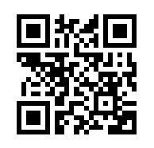
Exit Ticket
Use the QR code to fill out the exit ticket survey.

